Slide 1
Aug 17 - Aug 24, 2025
TODO list
Paper review on masked image modeling (MIM) ✅
Determine our initial motivation and idea ✅
Curate open source code and determine our codebase ❌
Other
Found a work similar to our motivation and idea
Sent an email to inquire about the code of a good work
Found a dataset suitable for our experiments
Need to discuss: we may need more compute resource

Slide 2
Masked Image Modeling (MIM)
Values
It shows scalable pre-training on unlabeled data, yielding transferable representations that consistently improve downstream tasks like detection
As the counterpart to MLM, MIM has the potential to drive transformative success in CV, mirroring the impact of self-supervised learning in NLP
Well-known researchers or institutions
BEiT: Furu Wei | Microsoft Research | ICLR 2022 3K cit.
MAE: Kaiming He | Meta FAIR | CVPR 2022 best paper nominee 11K cit. 7.9K stars
DINOv2: Piotr Bojanowski | Meta FAIR | TMLR 2024 5K cit. 11K stars

Slide 3
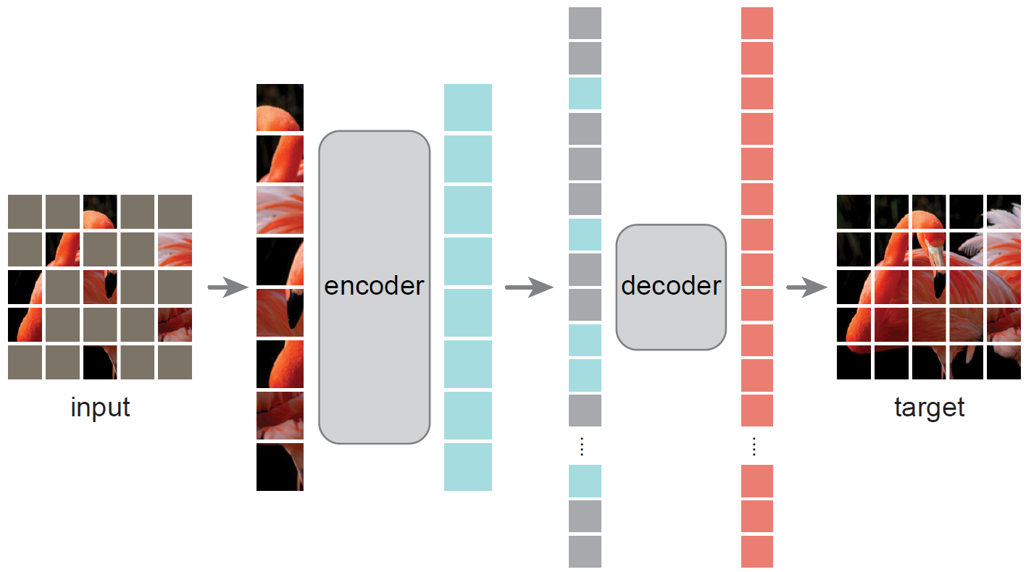
Related Works
MAE (Kaiming He | Meta FAIR | CVPR 2022 best paper nominee 11K cit. 7.9K stars )
Motivation: inspired by MLM, to learn better visual representations by scalable pre-training
Contribution: an efficient and effective framework, achieve SOTA on downstream vision tasks
Limitation: learn low-level reconstruction, may not align with high-level semantic understanding

Slide 4
Aug 10 - Aug 17, 2025
TODO list
……
Other
……

